Slide 1





DRONZA
Web Designing & Development
Guided by :- Asst. prof. Ashish Solanki

Slide 2






OUR TEAM
DISHANT PALADIYA
2214103230
FENIL MAKRUBIYA
2214103286
VANSH DONGA
2214103318
VANSH DONGA
2214103319

Slide 3
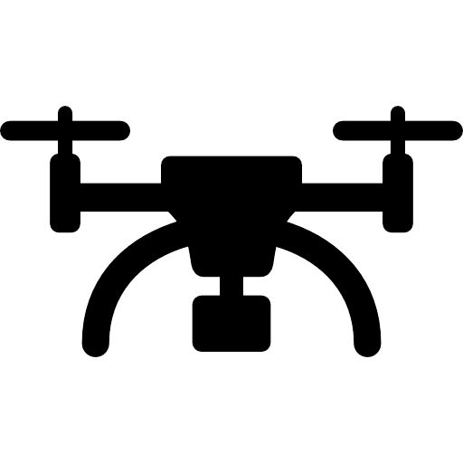

Overview
Introduction
Workflow
Scope and Planning
Designing
Testing
Conclusion
Bibliography

Slide 4



Introduction
A drone-selling website is an e-commerce platform designed to offer a wide range of drones for various purposes, including recreational, professional, and industrial use. It provides users with an intuitive interface to explore different models, compare features, and make secure purchases. The website includes essential functionalities such as user registration, product catalog, order management, and payment processing. With a responsive design and seamless navigation, it ensures a smooth shopping experience. Advanced search and filtering options help customers find the right drone easily. Integrated customer support and after-sales services enhance user satisfaction, making drone purchasing convenient and efficient.

Slide 5
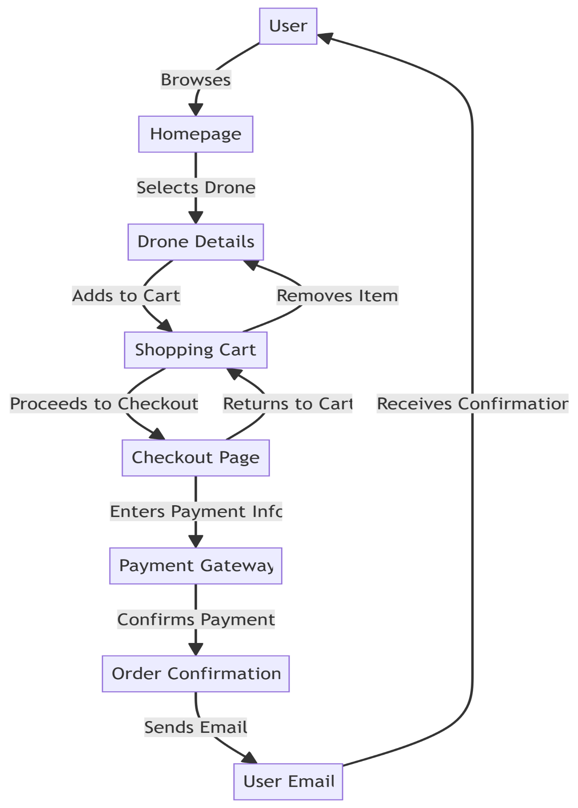
Work Flow

Slide 6




SCOPE & PLANNING
Scope:
Diverse Product Range – Drones for hobbyists, professionals, and businesses.
User-Friendly Shopping – Easy navigation, filters, and secure payments.
Scalability – Future expansion for new products and global reach.
Planning:
Tech Stack – React (frontend), PHP (backend), MySQL/NoSQL (database).
Security & Performance – SSL encryption, secure login, and fast loading.
Marketing & Support – SEO, social media promotions, and live chat assistance.

Slide 7
Designing
Key Considerations in Drone Design:
Airframe Design: Selecting an appropriate configuration—such as fixed-wing, multirotor, or hybrid—based on the drone's intended use and flight requirements.​
Material Selection: Use lightweight, durable materials like carbon fiber or aluminum alloys to enhance structural integrity and maneuverability.
Propulsion System: Select appropriate motors and propellers to ensure sufficient thrust and energy efficiency.
Power Source: Determine suitable battery types and capacities to balance flight duration and payload needs.

Slide 8
DATA FLOW DIAGRAM
Context Level DFD
01 1st Level DFD
02
2nd Level DFD

Slide 9
1st daigram

Slide 10
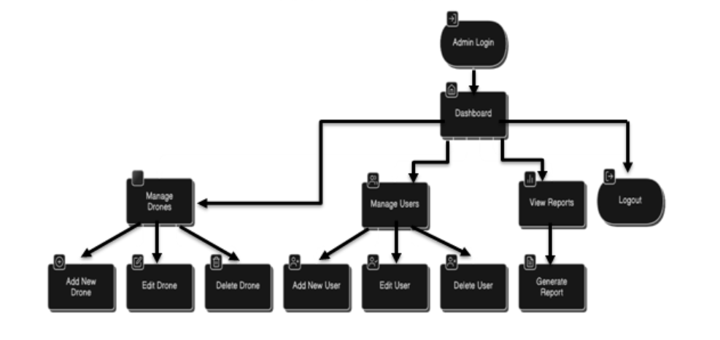
2nd daigram

Slide 11
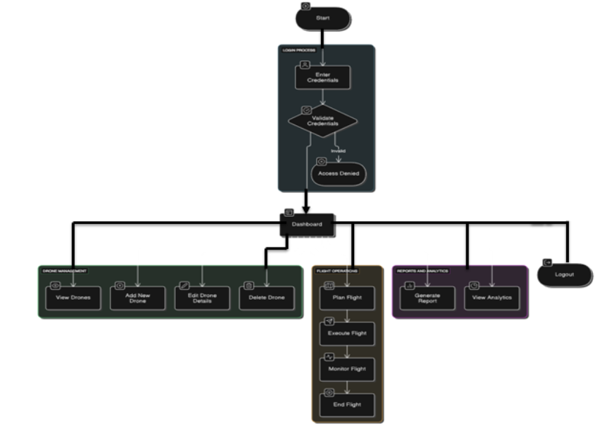
3rd daigram

Slide 12

Database table’s name
banner_data
Fnq
Login_data
Order
Product
Services_data

Slide 13
USER INTERFACE
Client side interface
Admin side interace

Slide 14

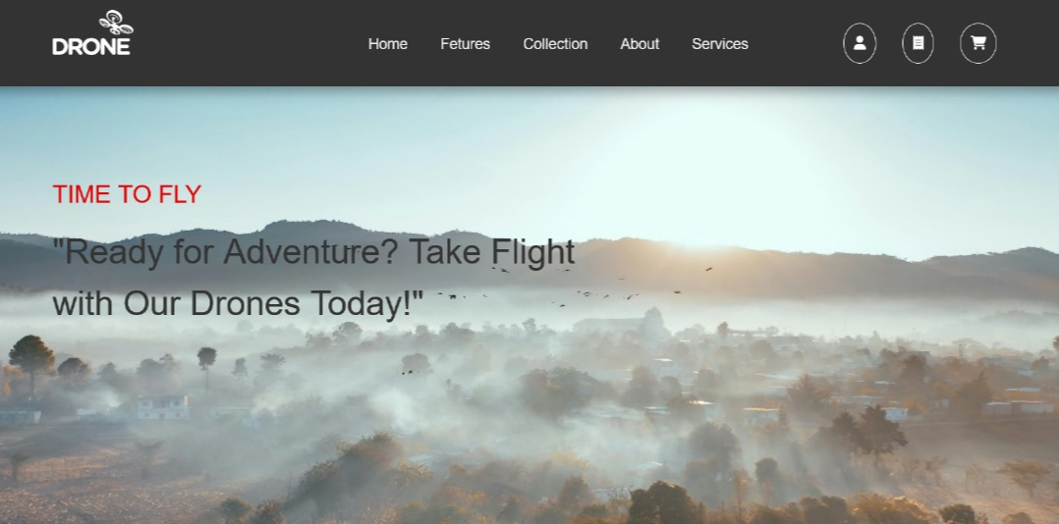
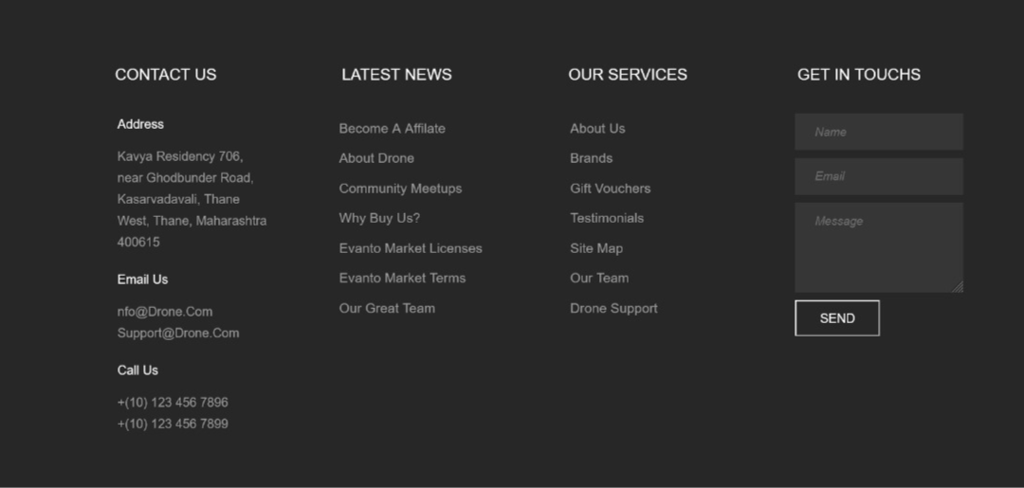
All Block of Dronza

Slide 15
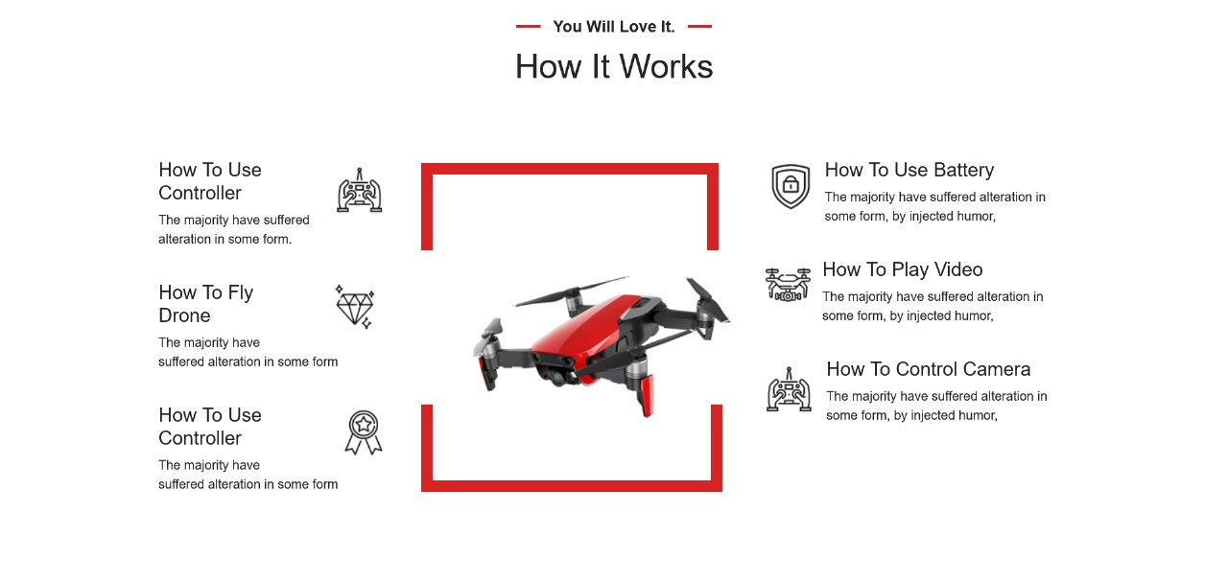
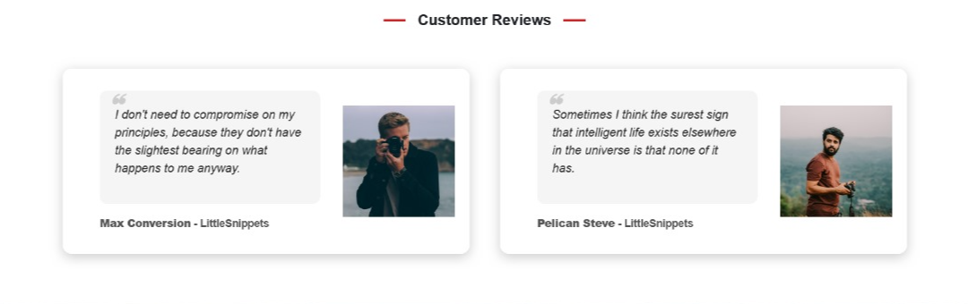

Slide 16
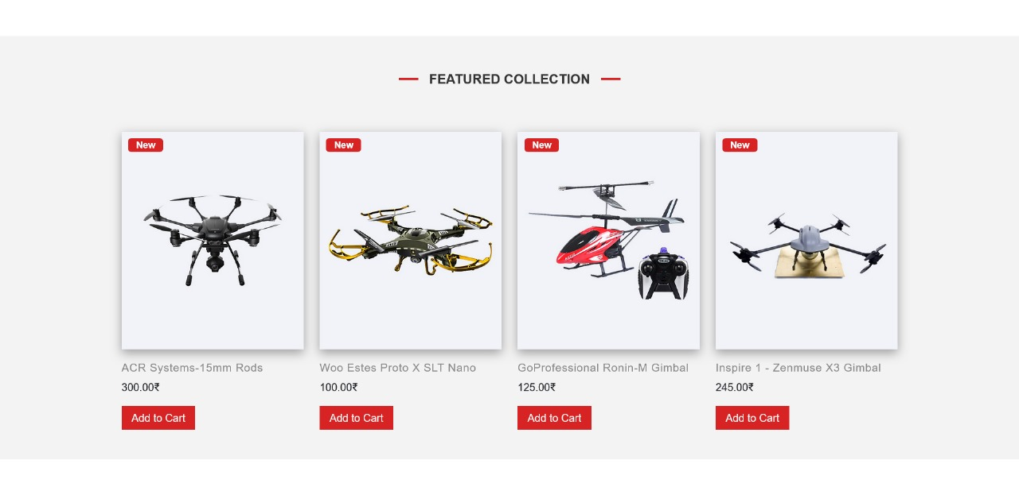
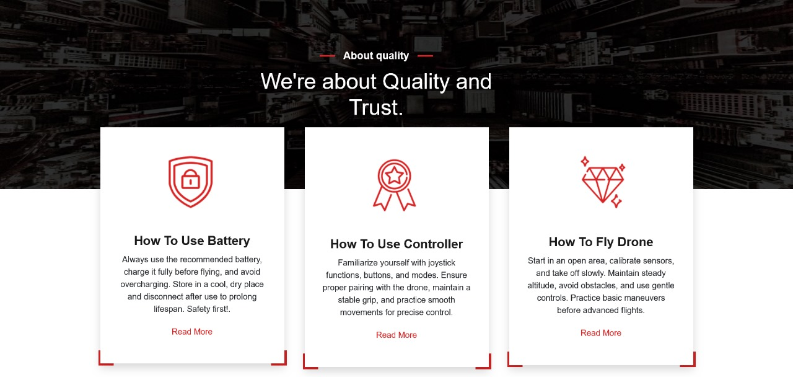

Slide 17
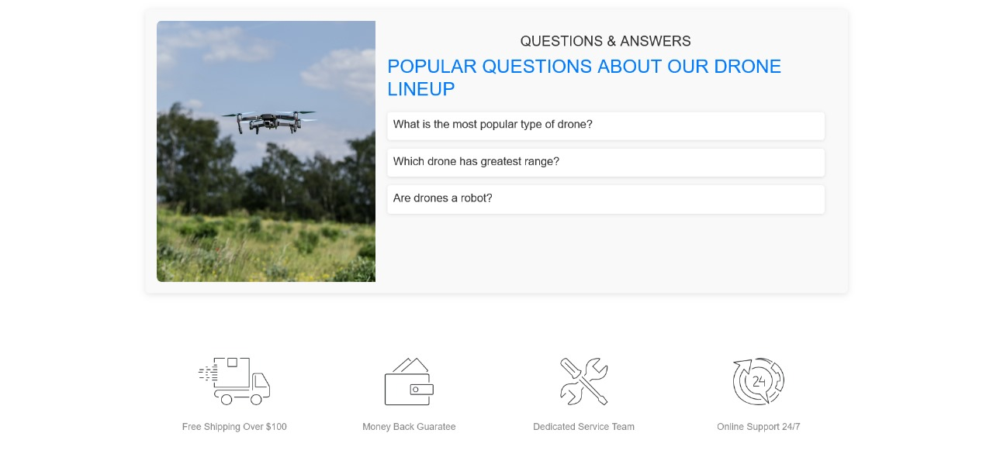
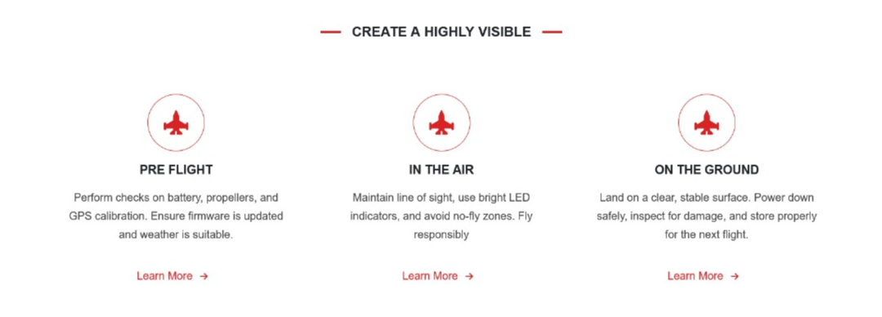

Slide 18


PRODUCT CATALOG
USER REVIEW’S
SECURE PAYMENT
PROCESSING
4. CUSTOMER SUPPORT
FUNCTIONALITY

Slide 19
UNIT TESTING
NAVIGATION TESTING
Testing
FUNCTIONAL TESTING
ENVIRONMENT TESTING

Slide 20


conclusion
The drone market is rapidly growing, valued at $73.06 billion in 2024, with a 14.3% CAGR projected until 2030. Industries like agriculture, defense, and e-commerce drive this demand. Online platforms play a key role by offering diverse drone products, user-friendly interfaces, and secure transactions. As drone adoption expands, these websites will be crucial in making drone technology more accessible and widely used.

Slide 21
Bibliography
YouTube Links:
DroneDJ : https://www.youtube.com/@DroneDJ
Captain Drone : https://www.youtube.com/@CaptainDrone
Drone Valley : https://www.youtube.com/@DroneValley
Billy Kyle : https://www.youtube.com/@BillyKyle
Reference Links:
Xboom
Jetayu Gadgets
Quadkart
Xbotics
DJI India Shop
TropoGo

Slide 22


Slide 23
Thank
you

